Slide 1
Project Delivery Team
Program Director/ Delivery Manager
1
Program Manager
2
Enterprise Architect/
Solution Architects
3
Team Leads
4
Developers/Testers
5
Your Logo

Slide 2
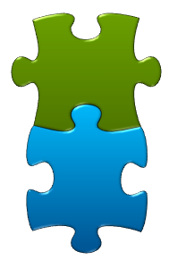
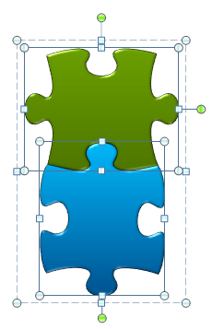
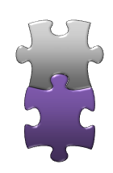
SDLC Waterfall Framework
Project Kick off
Design
HLD
LLD
Requirements
Analysis
Development
& Testing
Deployment
Maintenance

Slide 3
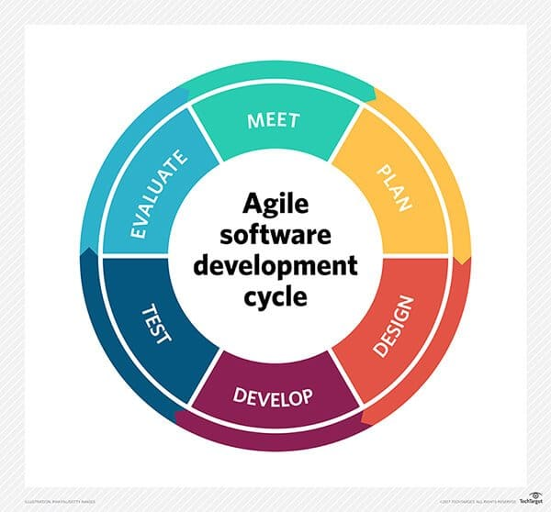
SDLC Agile Framework

Slide 4
Annual Revenues
Year | Revenues |  |  |  | Billion US$
 | Americas | EME | Asia | Far East | Total
2015 | 1.29 | 0.52 | 0.52 | 0.26 | 2.58
2016 | 1.54 | 0.61 | 0.61 | 0.31 | 3.07
2017 | 1.79 | 0.72 | 0.72 | 0.36 | 3.58
2018 | 1.98 | 0.79 | 0.79 | 0.40 | 3.97
2019 | 2.18 | 0.87 | 0.87 | 0.44 | 4.35
2020 | 2.27 | 0.91 | 0.91 | 0.45 | 4.54
2021 | 2.09 | 0.84 | 0.84 | 0.42 | 4.18
2022 | 2.35 | 0.94 | 0.94 | 0.47 | 4.69
2023 | 2.56 | 1.02 | 1.02 | 0.51 | 5.11

Slide 5
Global Market Size

